Slide 2
EXPENSES AND SALES REPORT OF XYZ COMPANY
Ferdoushi Akter
Batch No: 20
ID: 01-020-25
Department of Finance and Banking
Date: 05.10.24

Slide 3

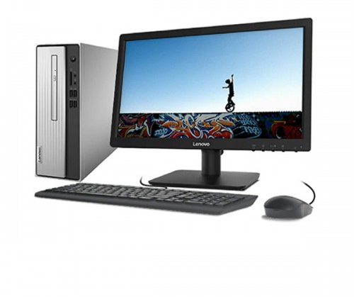
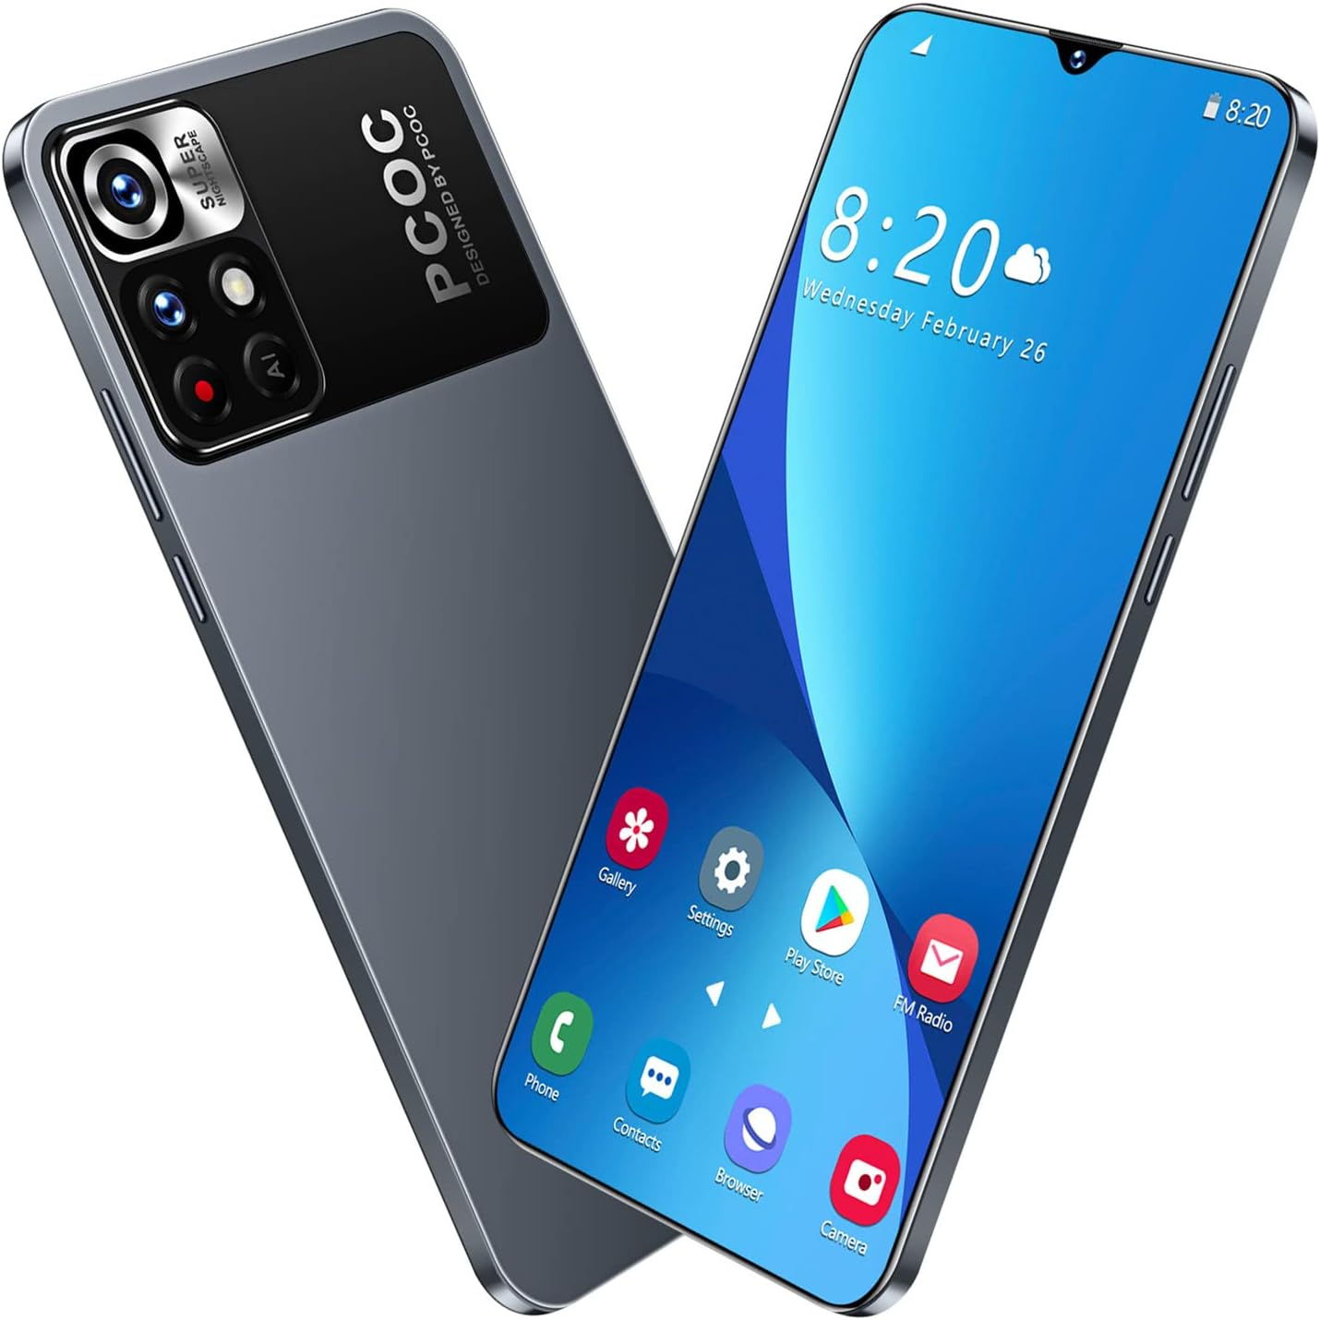
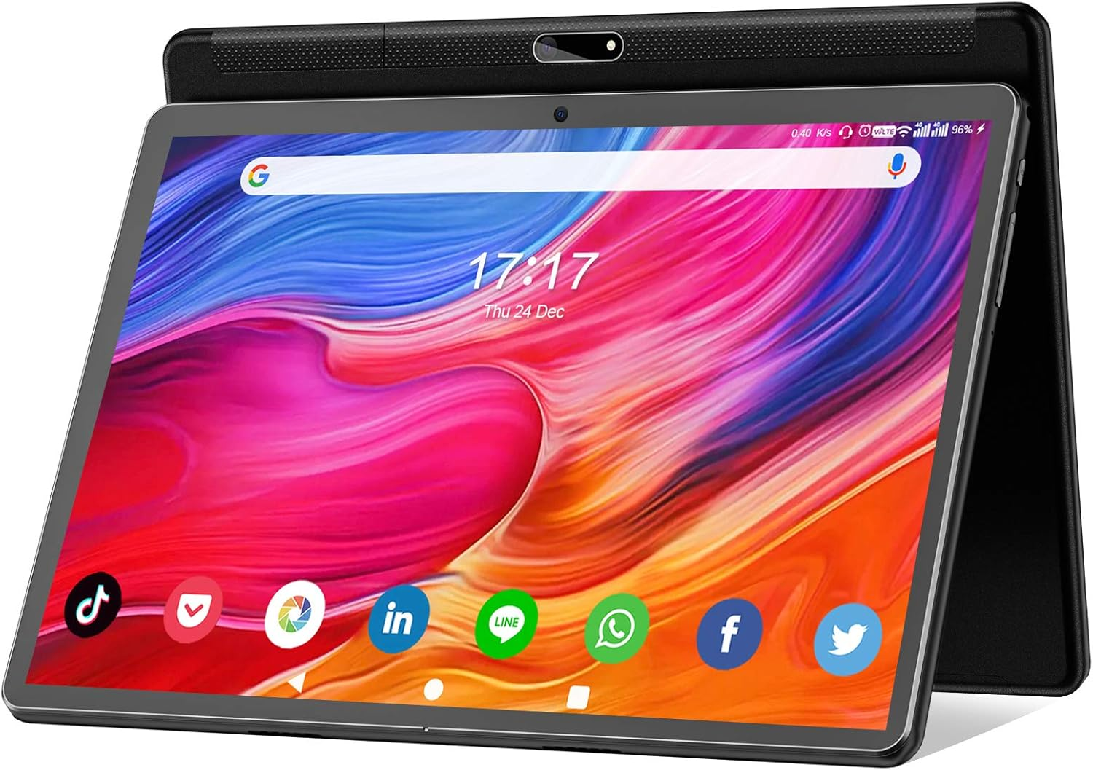



XYZ Company is a multinational technology company with a focus on innovative solutions using artificial intelligence and robotics. Established over three decades ago, XYZ Corporation has grown significantly and now operates in various global markets. Their mission is to integrate advanced technologies into everyday life, enhancing user experiences across different industries
Laptop
Desktop
Smartphone
Tablet
Replace
Reaper
Easy Return

Slide 4
Products and services of XYZ Company
PRODUCTS
Laptop
Desktop
Smartphone
Tablet
SERVICES
Replace
Repair
Easy Return

Slide 5
Product Expenses & Sales
Month | Expenses | Sales
January | 9288500 | 8750000
February | 9744300 | 9920000
March | 8904700 | 10000000
April | 7345200 | 7957400
May | 8987000 | 9876500
June | 5215400 | 5164500
July | 9976500 | 11543600
August | 7976700 | 8087900
September | 9879000 | 9969800
October | 6234800 | 7024000
November | 4534800 | 4809300
December | 8348700 | 8834800

Slide 6
Contact Us
Have a question or need assistance? We're here to help!
Customer Support - Phone: 09678-664664 - Email: contact@xyzcompany.com
Business Hours - based on our outlet
Accessibility We are committed to making our website accessible to all. If you encounter any accessibility issues, please let us know.
Don't hesitate to get in touch with us. We're here to provide you with exceptional customer service and support.
Complain/Feedback If you prefer, you can also fill out our contact form, and we'll get back to you shortly. click https://xyzcompany.com/feedback

Slide 7
Thank You

